Slide 1

Fingerprint Recognition With Minutiae Matching Score Method
By
Isfan Fauzi/13214024
Deddy Welson/13214148
Andhiki Supono/
Tugas Besar PCD EL4125
Kelompok 21

Slide 2

Why Fingerprint?
Powerful Technology
Simple Identification
Worldwide Unique System
Limited Access
Tugas Besar PCD EL4125
Kelompok 21

Slide 3

Input Image from Database
Preprocessing Image
Extraction Image
Postprocessing Signal and Scoring
4 main steps for Fingerprint Recognition System
Tugas Besar PCD EL4125
Kelompok 21

Slide 4
4 Main Steps of Fingerprint Recognition
Postprocessing Image
Input Image
Using Alignment, Pairing and scoring
Using Editable database.
Postprocessing
Input from database
Processing Image
Processing
Preprocessing
Prepocessing Image
Using Thin Layer and minutiae Extraction
Using Filter Gabor, merging
and local thresholding

Slide 5

Editable Database
Database
Postprocesing
Input from database
Database can be edited by adding or cleaning the image there. To manipulate database, there will be GUI to make it easier to do
processing
Preprocessing
Tugas Besar PCD EL4125
Kelompok 21

Slide 6

Filter Gabor and Masking
Prepocessing Image
postprocessing
Input form database
Gabor Filter is used to detail the image with any directions
Masking Filter is used to denoise the image from Gabor filter
processing
prepocessing
Tugas Besar PCD EL4125
Kelompok 21

Slide 7

Thin Layer and minutiae Extraction
Processing Image
postprocessing
Input from database
Thin Layer Extraction is used to make fingerprint pathway in detail
Minutiae Extraction is used to note main dots which are used to be compered with database
processing
prepocessing
Tugas Besar PCD EL4125
Kelompok 21

Slide 8

Alignment, Pairing and Scoring Image
Postprocessing
postprocessing
Input from database
In this part of process, the input image will be compared with all image in the database.
System would recognize the image by pairing and scoring image.
Alignment is used to compare both dots between 2 image in any directions
Pairing is used to determine dot in the same position
Scoring is used to calculate the distance between 2 dots from pairing process
processing
preprocessing
Tugas Besar PCD EL4125
Kelompok 21

Slide 9
What is the result?
Input
Proprocessing
Processing
Postprocessing
Tugas Besar PCD EL4125
Kelompok 21

Slide 10
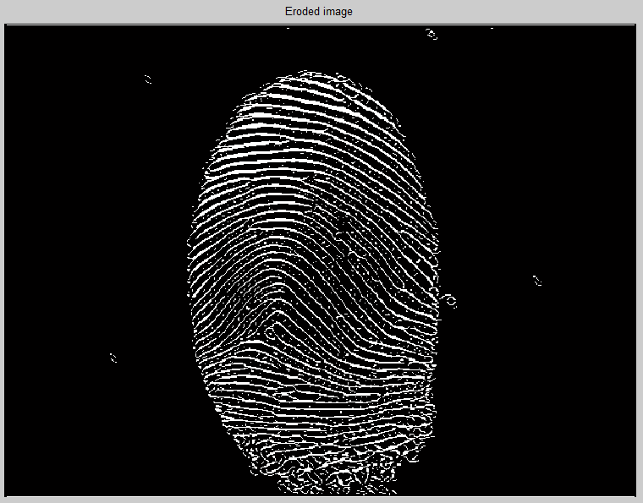
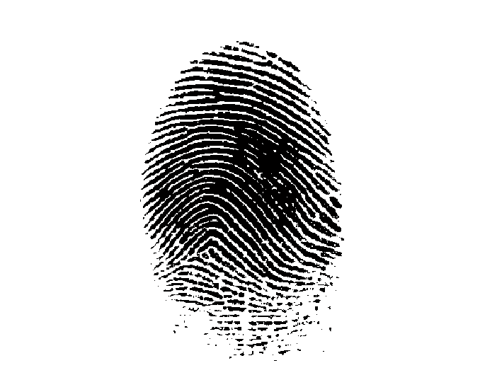
What is the result?
Input
Proprocessing
Processing
Postprocessing
Tugas Besar PCD EL4125
Kelompok 21

Slide 11
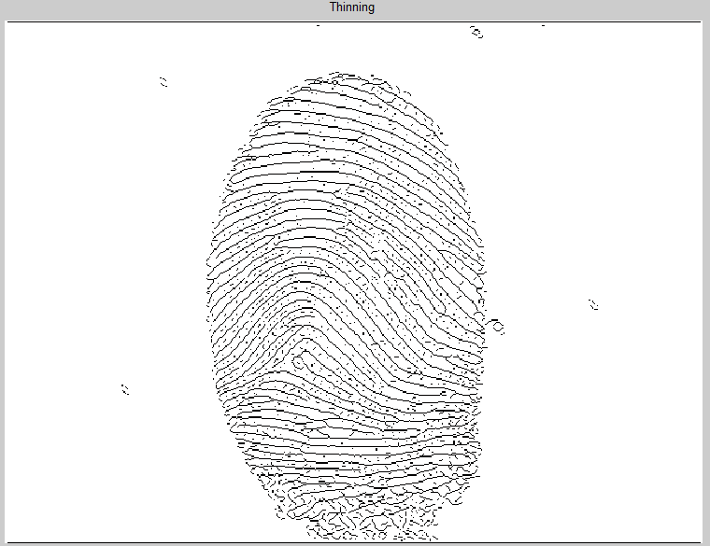
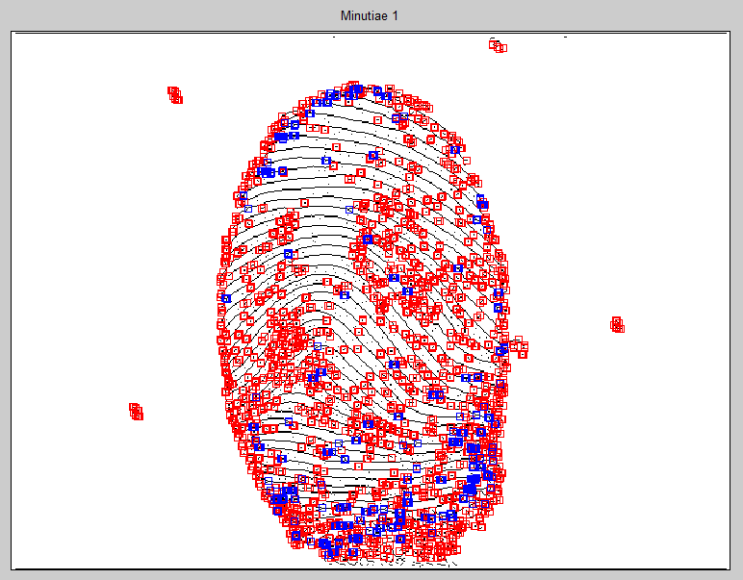
What is the result?
Input
Proprocessing
Processing
Postprocessing
Tugas Besar PCD EL4125
Kelompok 21

Slide 12
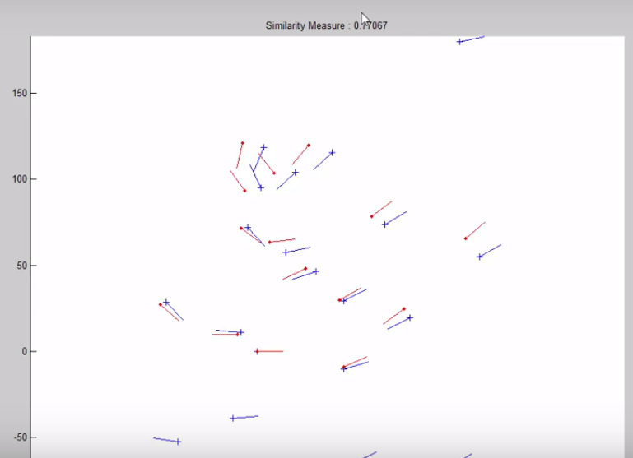
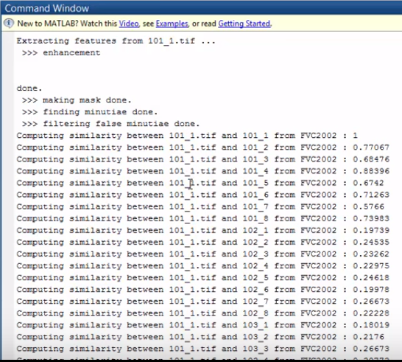
What is the result?
Input
Proprocessing
Processing
Postprocessing
Tugas Besar PCD EL4125
Kelompok 21

Slide 13
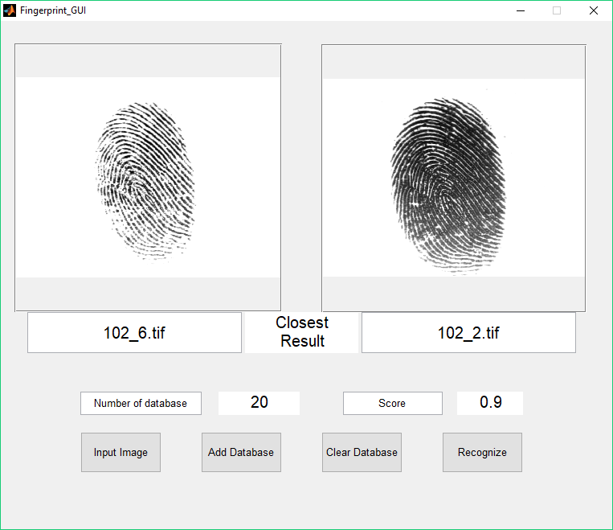
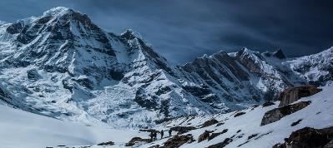

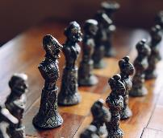
What is the result?
Input Image
Recognize with Score
Database
GUI
Tugas Besar PCD EL4125
Kelompok 21

Slide 14


Conclusion
This application of fingerprint detection has many benefits especially for biometrical Security application. These are some benefits from this experiments
Fingerprint Rec. is implemented well
Editable Database
Matlab based-App
Simple Detection
Easy to Use with GUI
Tugas Besar PCD EL4125
Kelompok 21

Slide 15

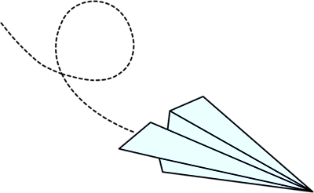
Thank You!
Any Question?
Tugas Besar PCD EL4125
Kelompok 21

